Slide 1


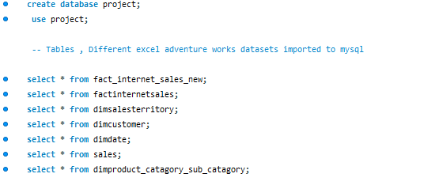

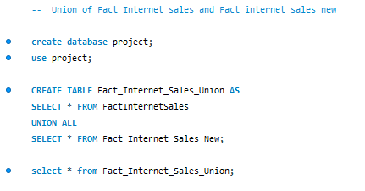
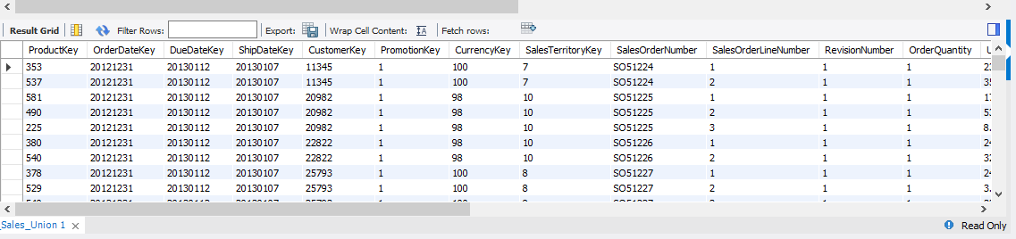
MySQL Project : Adventure work cycles
Adventure works excel datasets imported to MySQL
Union of Fact Internet sales and Fact internet sales new

Slide 2
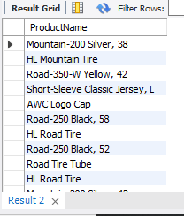
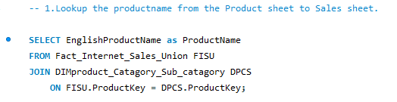
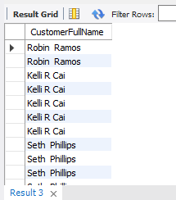
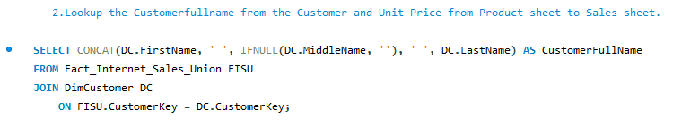
Lookup the Product Name from the Product sheet to Sales sheet.
Lookup the Customer Full Name from the Customer and Unit Price from Product sheet to Sales sheet.

Slide 3
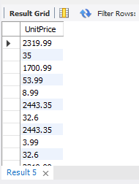
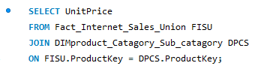
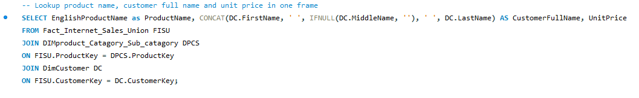
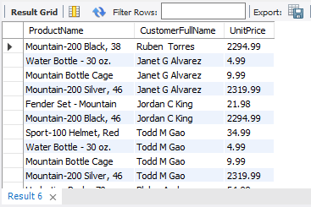
Lookup the Unit Price from Product sheet to Sales sheet.
Lookup product name, customer full name and unit price in one frame

Slide 4
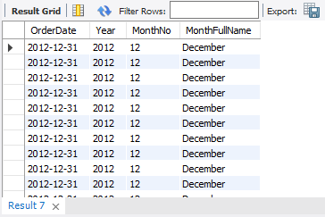
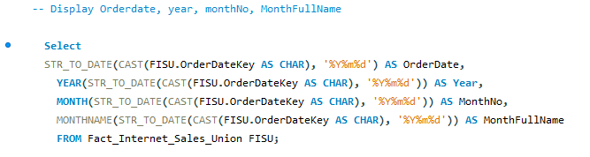
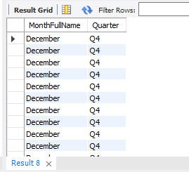
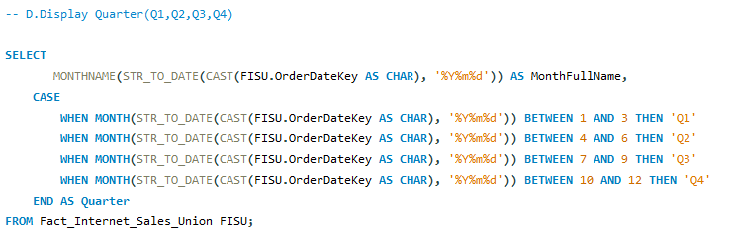
Calculate the following fields from the Orderdatekey field ( First Create a Date Field from Orderdatekey)
Display Order Date, Year, MonthNo, Month Full Name
Display Quarter(Q1,Q2,Q3,Q4)

Slide 5
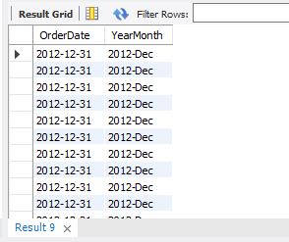
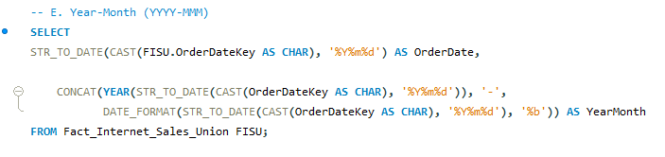
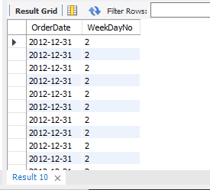
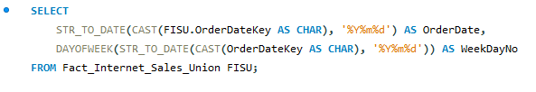
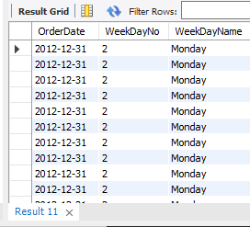
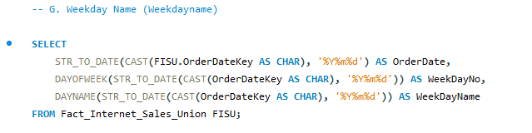
Display Year-Month (YYYY-MMM)
Display Weekday Number (Weekdayno)
Display Weekday Name (Weekdayname)

Slide 6
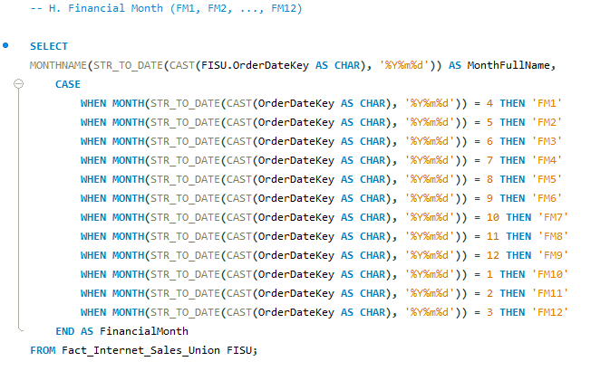
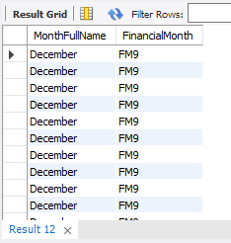
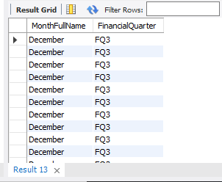
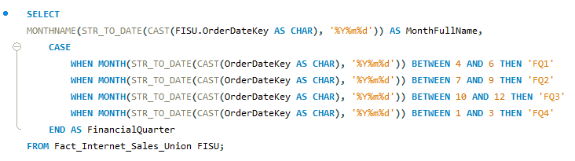
Display Financial Month (FM1, FM2, ..., FM12)
Display Financial Quarter (FQ1, FQ2, FQ3, FQ4)

Slide 7
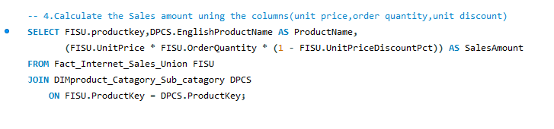
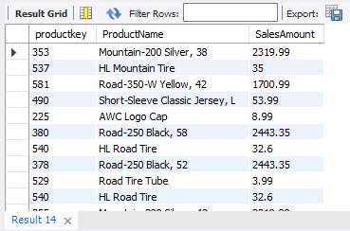
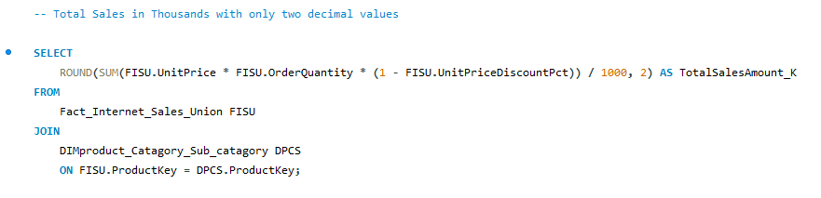

Calculate the Sales amount using the columns(unit price, order quantity, unit discount)
Total Sales (KPI ) in Thousands (K) with two decimal values

Slide 8
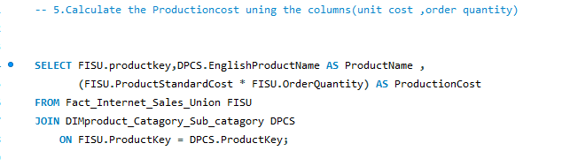
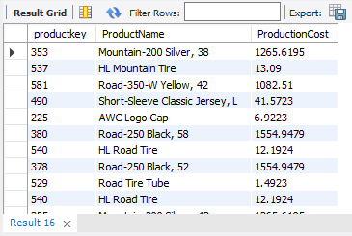
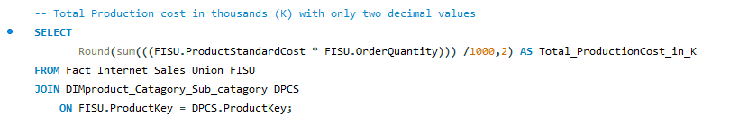

Calculate the Production Cost using the columns (unit cost, order quantity)
Total Production cost (KPI) in thousands (K) with two decimal values

Slide 9
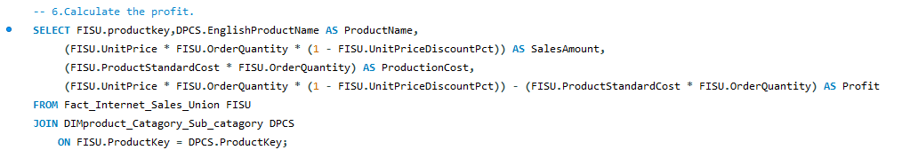
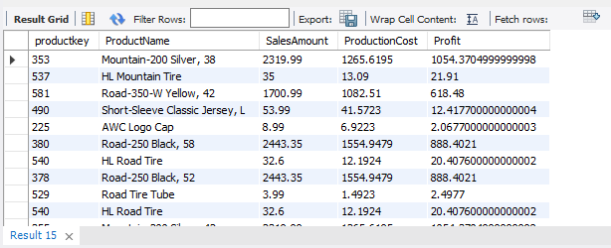
Calculate the profit, Display Sales amount, Production Cost and Profit

Slide 10
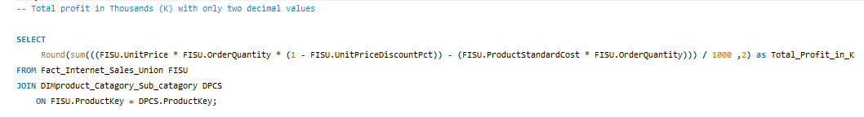

Display Total profit (KPI) in thousands (K) with two decimal values

Slide 11
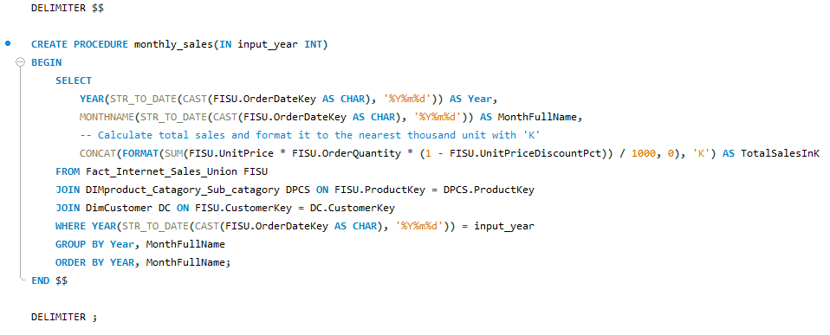
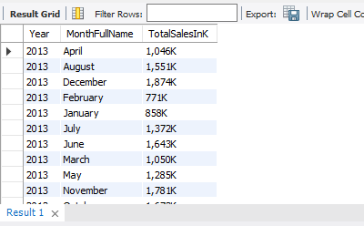
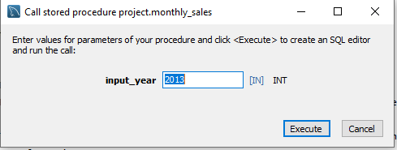
Stored procedure : to filter the year to display monthly Sales Amount

Slide 12
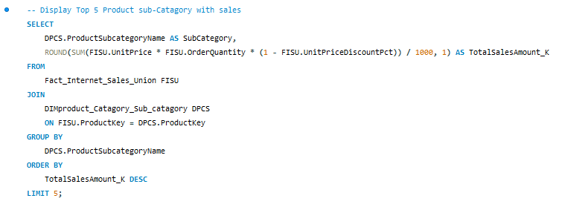
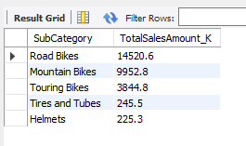
Display Top 5 Product Sub-Category with Sales

Slide 13
Thank You

